Slide 1
Ruby Training: Variables
Matthew Eakin, Manager
Managed Testing Practice
Sogeti, USA
Matthew.Eakin@us.sogeti.com

Slide 2
Agenda
Note: this is the 2nd of a series of 3 presentations (Methods, Variables, Class Objects). It is recommended you complete these in order as the examples here are based on the Methods presentation
Declaring variables
Ruby Constants
Ruby Variables are dynamic
Variable Scope
Local Variables
Global Variables
Instance Variables
Class Variables
Ruby Constant Scope

Slide 3
Declaring a Variable
Variables are declared and assigned values by placing the variable name and the value either side of the assignment operator (=)
An example: my_new_neighbor = “Jamey”
We have declared the variable “my_new_neighbor” and assigned it the value “Jamey”
Ruby supports parallel assignment – the ability to assign values to a number of variables
This code: Can become this:
a = 10 a, b, c, d = 10, 20, 30, 40
b = 20
c = 30
d = 40

Slide 4
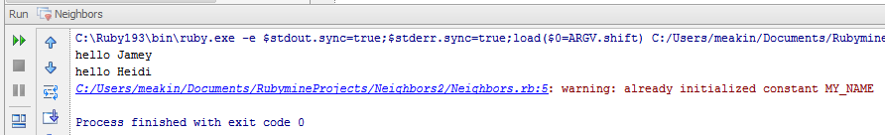
Ruby Constants
Constant variables in Ruby allow you to store a value for the duration of the program
Ruby requires 1st character to be capitalized: “Variable_one”
Good naming convention is to use all caps: “VARIABLE_ONE”
You can change the value of the Constant, but Ruby is not going to like it
Update your code and run
MY_NAME = "Matthew"
MY_NAME = "Matthew Eakin"
hello_neighbor("Jamey")
hello_neighbor("Heidi")
Will get these results:

Slide 5
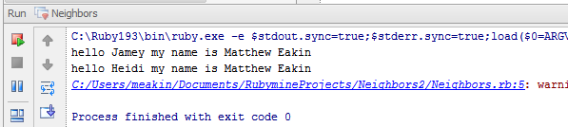
The Scope of Constants
Constants declared within a class or module are available anywhere within the context of that class or module
Constants declared outside of a class or module are assigned global scope
Update your code and run the file: Will get these results:
def hello_neighbor(neighbor)
puts "hello #{neighbor} my name is #{MY_NAME}"
end
MY_NAME = "Matthew"
MY_NAME = "Matthew Eakin"
hello_neighbor("Jamey")
hello_neighbor("Heidi")

Slide 6
Variable Types
Many programming languages require that you declare what type of variable it is when you create it
JAVA: String my_new_neighbor;
.NET: Dim my_new_neighbor as String;
With Ruby you don’t have to declare what type of variable it is
Simply declare it and assign it a value
my_new_neighbor = “Jamey”

Slide 7
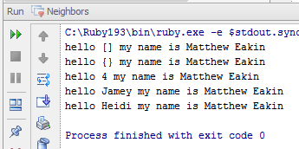
Dynamic variable types
Unlike many other programming languages, variable types in Ruby are not set in stone
Rather, they can be changed at any time by simply assigning the variable a new value
Update your code and run this: Will get these results:
#MY_NAME = "Matthew"
MY_NAME = "Matthew Eakin"
#hello_neighbor("Jamey")
#hello_neighbor("Heidi")
neighbor_dad = Array.new
hello_neighbor(neighbor_dad)
neighbor_dad = Hash.new
hello_neighbor(neighbor_dad)
neighbor_dad = 4
hello_neighbor(neighbor_dad)
neighbor_dad = "Jamey"
hello_neighbor(neighbor_dad)
neighbor_mom = "Heidi"
hello_neighbor(neighbor_mom)

Slide 8
Explicitly Changing variable types
Ruby enables you to more explicitly change the variable type
All variable types have a built-in “to_x” method, where x stand for the data type
Examples:
my_new_neighbor.to_f #converts variable to a Float
my_new_neighbor.to_i #converts variable to an Integer
my_new_neighbor.to_s #converts variable to a String

Slide 9
What type of variable do you have?
All objects in Ruby have a method called “kind_of?”
It will return what type of variable it currently is
neighbor_dad.kind_of? #will return String
neighbor_dad.kind_of? String #will return true

Slide 10
Variable Scope
Local Variables
Not available outside a method
Must begin with a lowercase or “_”
Instance Variables
Available across methods within the object
Available only during the current instance
Must begin with a “@”
Class Variables
Available across objects but belong to the class and is a characteristic of that class
Must begin with a “@@”
Available for the duration of the class
Global Variables
Available across classes
Must begin with a “$”

Slide 11
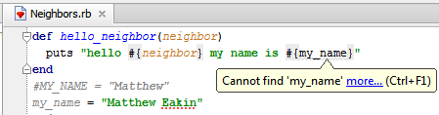
Local Variables
Local Variables
Not available outside a method
Must begin with a lowercase or “_”
Update the method as follows: will get these results:
def hello_neighbor(neighbor)
puts "hello #{neighbor} my name is #{my_name}"
end
#MY_NAME = "Matthew"
my_name = "Matthew Eakin"
Notice how RubyMine tells you that it cannot find “my_name”
RubyMine also adds the grey squigly underline to highlight it
REASON: “my_name” is not defined in the method. It is local outside the method

Slide 12
Global Variables
Global Variables are variables available anywhere within the Ruby application regardless of where they were declared
Declared in Ruby by putting a single “$” in front of the variable name
Use with caution
Update your code and run the file: Will get these results:
def hello_neighbor(neighbor)
puts "hello #{neighbor} my name is #{$my_name}"
end
#MY_NAME = "Matthew"
$my_name = "Matthew Eakin"

Slide 13
Instance Variables
Instance Variables are variables available for that specific instance of the object
Declared in Ruby by putting a single “@” in front of the variable name
Update your code and run the file: Will get these results:
def hello_neighbor(neighbor)
puts "hello #{neighbor} my name is #{@my_name}"
end
#MY_NAME = "Matthew"
@my_name = "Matthew Eakin"

Slide 14
Class Variables
Class Variables are variables only available within the class object in which it was declared
Important note: Even if you create multiple instances of a class object, the class variable will retain only one value. It will not retain a different value for each instance
Declared in Ruby by putting a double “@@” in front of the variable name
***More on Class Variables in the Class Object lesson***

Slide 15
Thank you

